Slide 1


AI/ML-Driven VLSI Design Optimization: Machine learning for Circuit Layout Optimization
Review-I
AY 2025-26
Capstone Project – Introduction (PROJ2999)
GITAM (Deemed-to-be) University
Department of Electrical Electronics and Communication Engineering
Project Team:
Jerripothula Keerthy- BU22EECE0100221
Honalu K.G - BU22EECE0100452
Meghavardhan Reddy- BU22EECE0100515
Project Mentor: Karthick.S
Project In-charge: Jayaprakash Sahoo
www.gitam.edu

Slide 2
Objective and Goals
Objective
To investigate the application of AI and ML techniques to optimize VLSI circuit design, with a specific focus on automated placement and routing optimization.
To evaluate a hybrid framework combining genetic algorithms (GA) and reinforcement learning (RL) to automate VLSI layout optimization processes to achieve improvements in Power, Performance, and Area (PPA) metrics while maintaining signal integrity.
Goals
Develop AI-enhanced optimization algorithms for automated VLSI placement and routing.
Implement a comprehensive framework that simultaneously optimizes power consumption, performance, area efficiency, and signal integrity.
Demonstrate the effectiveness of the proposed approach through experimental validation using industry-standard benchmarks.

Slide 3
PROBLEM STATEMENT
The primary challenges addressed in this research include:
1. Complexity Management: Modern VLSI designs involve millions of design variables and constraints, creating optimization problems of unprecedented complexity that exceed the capabilities of traditional heuristic approaches.
2. Multi-Objective Optimization: Achieving optimal trade-offs between conflicting objectives such as power consumption, performance, area utilization, and signal integrity requires sophisticated optimization techniques.
3. Design Time Constraints: Increasing market pressures demand shorter design cycles while maintaining or improving quality metrics, necessitating more efficient optimization methodologies.
4. Technology Scaling Challenges: As semiconductor technology scales to smaller nodes, new physical effects and design constraints emerge that traditional tools struggle to handle effectively.

Slide 4
Project Plan (Clearly mention milestone for objectives under each reviews)
TASK/TIME | AUGUST 2025 | SEPTEMBER 2025 | OCTOBER 2025 | NOVEMBER 2025 | DECEMBER 2025 | JANUARY 2026 | FEBRUARY 2026 | MARCH 2026 | APRIL 2026
PROJECT SELECTION
IDENTIFICATION PROBLEM
LITERATURE SERVEY
IDENTITATION OF TOOLS/ ALGORITHMS
MODEL DESIGN
MODEL IMPLEMENTATION
SYSTEM TESTING
SYSTEM DEPLOYMENT

Slide 5
Literature Survey
TITLE & AUTHOR | METHODOLOGY | RESULT | PROBLEM STATEMENT
“Power Estimation of Digital VLSI Circuits Using Machine Learning” Manish I. Patel And Srushti Patel 2024 | Circuits were designed in Verilog,features collected using Quartus, power measured using powerplay, a dataset was made. ML Models used: four ML models (Tree Regression, Gaussian Process, SVM, Ensemble) were trained in MATLAB With 5-fold crossvalidation Comparison Metrics: R² (accuracy) and RMSE (error). | Tree Regression performed best. Achieved R² ≈0.98 (very high accuracy) and RMSE ≈ 0.296 (low error). Proved that ML models can predict power much faster than traditional simulations. | At higher abstraction levels → fast but less accurate. At lower abstraction levels → accurate but very slow and time- consuming. As designs grow bigger, these simulation methods become too slow and computationally expensive.

Slide 6
TITLE & AUTHOR | METHODOLOGY | RESULT | PROBLEM STATEMENT
“Machine Learning Based Power Estimation for CMOS VLSI Circuits” V . Govindaraj and B. Arunadevi 2021 | Training and testing performed on the ISCAS’89 benchmark dataset. The data was normalized and used to train BPNN and RF models. RF was tuned with 10-fold cross- validation and further optimized using NSGA-II. Comparison Metrics: RF and BPNN were compared using Error %, MSE, RMSE, and R. | Random Forest achieved very accurate predictions (Error 1.4%–6.8%, MSE =1.46E-06, RMSE = 0.000116, R = 0.99938) and clearly outperformed BPNN. | Neural networks like BPNN also need large data and more computation time. A faster, simpler, and accurate method is needed.

Slide 7
TITLE & AUTHOR | METHODOLOGY | RESULT | PROBLEM STATEMENT
“Power Consumption Prediction of Digital Circuits using Machine Learning” Modi Divy Bhavesh; Nair Anoopkumar Anilkumar; Dipesh Panchal; Manish I. Patel; Ruchi Gajjar 2022 | Built dataset from small circuits (PMOS RLI, NMOS RLI, CMOS NAND gate). ML Models: Linear, Polynomial, Decision Tree, Random Forest , Extra Tree. Training & Testing: Divided data into training and testing sets. Evaluated models using R², and MSE. | For RLI circuits, Extra Tree perform best. For NAND circuits, Polynomial Regression perform best. Overall, ML models predicted power accurately and faster than traditional simulations. | As circuits grow larger, these methods become impractical. A faster and reliable method is needed.

Slide 8
TITLE & AUTHOR | METHODOLOGY | RESULT | PROBLEM STATEMENT
“Power Estimation of Synchronous Sequential VLSI Circuits Using Boosting Techniques” Givari Santhosh, Ajay Singh Raghuvanshi 2023 | Used three machine learning algorithms – AdaBoost, Gradient Boosting, and Extreme Gradient Boosting – on ISCAS’89 benchmark circuits. Data was normalized and parameters optimized using Grid Search & Random Search to improve accuracy. Comparison Metrics: MSE, RMSE and R score. | Gradient Boosting with Grid Search performed best (R = 0.99746, RMSE = 3.143e- 5). It accurately predicts power, reducing the need for time- consuming simulations. | Traditional SPICE simulations for power estimation are slow and costly. As chips get complex, early power prediction becomes essential to avoid chip damage and speed up design

Slide 9
TITLE & AUTHOR | METHODOLOGY | RESULT | PROBLEM STATEMENT
“Power Prediction of VLSI Circuits Using Machine Learning” E. Poovannan, S.Karthik | Developed a ML-CPE (Machine Learning-based Circuit Power Estimation) using regression models: Linear Least Squares, Ridge, K-Nearest Neighbors, and Multi- Layer Perceptron. Utilized CNN architecture for feature extraction from netlists and simulation logs. Simulated ISCAS’89 benchmarks and used SPEF data for parasitic modeling. | Achieved prediction accuracy with error rates below 6%. Reduced simulation time from hours to milliseconds. Demonstrated scalability across filter sizes and circuit types. Validated performance using training/testing datasets and error analysis. | VLSI power estimation during testing is slow and costly. Full test vector simulation is impractical. Worst-case power scenarios may be missed. A predictive method is needed to spot high-power tests efficiently.

Slide 10
TITLE & AUTHOR | METHODOLOGY | RESULT | PROBLEM STATEMENT
“GLAAPE: Graph Learning Assisted Average Power Estimation for Gate- level Combinational Designs” — Rakesh M B, Sai Pranav K R, Pabitra Das, Amit Acharyya — Department of Electrical Engineering, IIT Hyderabad — IEEE ICECS 2022 | Converts gate-level netlists into graph structures using Networkx and DGL. Assigns node features (static probabilities, switching probabilities, inversion flags) and edge features (16 transition correlation coefficients + 1 state correlation coefficient). Uses an inductive GNN architecture with modified message passing and GCN aggregator. Trains on toggle rates from gate- level SAIF files; tests using RTL SAIF input toggle rates. Architecture: FC1 (4→128), GNN Layer, FC2 (128→16), FC3 (16→4 with softmax). | Average power estimation accuracy: GLAAPE 95.63%, outperforming GRANNITE (92.35%) and CRPET (70.35%). Toggle rate prediction accuracy: GLAAPE 83.43%, vs GRANNITE 69.48%. Inference throughput: GLAAPE 2.04 kHz, 15.69× faster than CGPET (0.13 kHz). Transferability: 13.95% improvement over GRANNITE in predicting unseen logic cells. | Existing power estimation methods trade off between accuracy (gate-level) and speed (RTL), while ML models lack transferability and need retraining for new designs. A fast, accurate, and transferable solution is needed GLAAPE addresses this by learning toggle rate propagation using inductive GNNs.

Slide 11
TITLE & AUTHOR | METHODOLOGY | RESULT | PROBLEM STATEMENT
“The Meritorious Effects of Machine Learning Algorithms in Assessment of Power Consumption by Arithmetic Circuits in IC Design” Saravanakumar C, Sasikala A, Sivanantham P, Syed Nasruddin S, Sowmiya P, Subhashini N | Six machine learning algorithms (Constant Model, Linear Regression, Neural Networks, kNN, SVM, AdaBoost) were trained on ISCAS'89 benchmark circuits using Orange Data Mining Tool. Input features included number of gates, PIs, POs, logic types. Performance was evaluated using RMSE, MAE, and R² metrics | AdaBoost achieved the lowest RMSE (0.006), showing superior performance compared to other models. The constant model performed worst, making it unsuitable. The study demonstrates that ML-based powerestimation is feasible without prior knowledge of | 1. Limitations of Traditional Methods: Power estimation is slow, resource-heavy, and needs detailed circuit knowledge. 2. Need for Advancement: A faster, accurate, and data-driven method is required for early-stage power estimation.

Slide 12
TITLE & AUTHOR | METHODOLOGY | RESULT | PROBLEM STATEMENT
“High-Level Early Power Estimation of FPGA IP Based on Machine Learning” Majdi Richa, Jean- Christophe Prévotet, Mickaël Dardaillon (Univ Rennes, INSA Rennes, CNRS, IETR), Mohamad Mroué, Abed Ellatif Samhat (Lebanese University) | Developed a fully automated measurement system (ACDGAS) to collect real power data, then trained a supervised ANN using control signals (CS), Switching Rate (SR), and Percentage Level High (PLH). The neural network model was implemented in TensorFlow/Keras, trained with 80-20 split, optimizedusing Adam and SeLU activation | Achieved <1% Mean Absolute Percentage Error (MAPE) for average power estimation on FPGA IP circuits (Xilinx Artix-7). Showed scalability and suitability for early-stage power prediction, potentially enabling runtime power management with DVFS in the future | Early-stage FPGA power estimation is challenging. Tight power budgets increase the difficulty. Existing methods are either slow (low-level sims) or inaccurate (simplified models). This leads to unreliable power predictions.

Slide 13
TITLE & AUTHOR | METHODOLOGY | RESULT | PROBLEM STATEMENT
“GLAAPE: Graph Learning Assisted Average Power Estimation for Gate- level Combinational Designs” Rakesh M B, Sai Pranav K R, Pabitra Das, Amit Acharyya (IIT Hyderabad) | Proposed GLAAPE, an inductive Graph Neural Network (GNN)-based model that learns toggle rate propagation using node and edge features extracted from netlist graphs. Trained with gate- level SAIF file data (ground truth) and tested on unseen circuits using RTL simulation input toggle rates | . Achieved 95.63% average power estimation accuracy, outperforming commercial RTL tools (CRPET) by 25.28% and GRANNITE by 3.28%. Inference throughput was 15.69× faster than commercial gate-level tools (CGPET), proving GLAAPE’s efficiency and transferability | Gate-level power estimation is accurate but slow. RTL-based estimation is faster but less accurate. Need for a fast, accurate, and generalizable power estimation method. Should work well on unseen circuits.

Slide 14
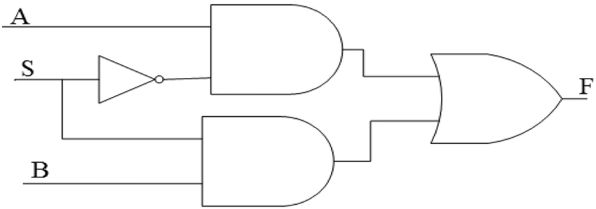
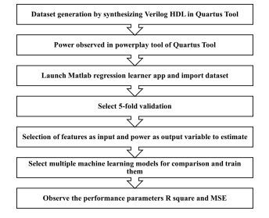
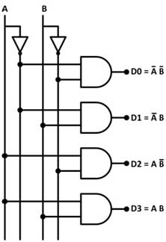
Architecture
Structural Diagram:
2X1 MUX
2X4 DECODER
Behaviour Diagram:

Slide 15
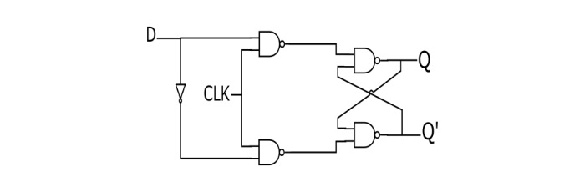
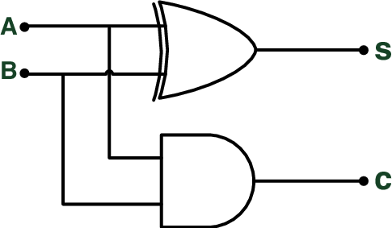
Architecture
Structural Diagram:
D FILPFLOP
HALF ADDER

Slide 16
Use Cases & Testing
Use Cases
Power Optimization: The framework reduces power consumption by up to 25%.
Design Cycle Reduction: It reduces design closure time by 34%.
Multi-Objective Optimization: The approach simultaneously optimizes conflicting objectives, achieving significant gains across the board.
Test Cases
The framework is validated using industry-standard benchmarks and custom test cases.
Performance is measured using metrics like power consumption (mW), area efficiency (%), and signal integrity metrics.
The approach is compared against traditional simulated annealing and commercial EDA tools.

Slide 17
Implementation and Results – Iteration 1
Iteration 1 : Results

Slide 18
Implementation and Results – Iteration 2
Iteration : Results + Validation against the use cases and test cases

Slide 19
Implementation and Results – Iteration 3 (Optional)
Iteration : Results + Validation against the use cases and test cases

Slide 20
Conclusion & Future Work
Summary and Conclusion
This thesis presented a comprehensive investigation of AI/ML applications to VLSI design optimization, demonstrating significant advances over traditional methods. The hybrid GA-RL framework successfully addresses the complex, multi-dimensional challenges of modern semiconductor design.
Future Work
Enhanced Interpretability: Develop explainable AI techniques to provide designers with insights into optimization decisions.
Transfer Learning: Investigate how to transfer optimization knowledge between similar design problems to reduce training time.
Expanded Application: Adapt the approach for other domains, such as analog and mixed-signal circuits.

Slide 21
THANK YOU
Have a Great Day !

